Slide 1
Semantic Similarity using WordNet

Slide 2
WordNet
What is WordNet and why is it interesting/useful?
A bit of history
WordNet for natural language processing/word sense disambiguation

Slide 3
What is WordNet?
A large lexical database, or “electronic dictionary,” developed and maintained at Princeton University
http://wordnet.princeton.edu
Includes most English nouns, verbs, adjectives, adverbs
Electronic format makes it amenable to automatic manipulation
Used in many Natural Language Processing applications (information retrieval, text mining, question answering, machine translation, AI/reasoning,...)‏
Wordnets are built for many languages (including Danish!)‏

Slide 4
What’s special about WordNet?
Traditional paper dictionaries are organized alphabetically: words that are found together (on the same page) are not related by meaning
WordNet is organized by meaning: words in close proximity are semantically similar
Human users and computers can browse WordNet and find words that are meaningfully related to their queries (somewhat like in a hyperdimensional thesaurus)‏
Meaning similiarity can be measured and quantified to support Natural Language Understanding

Slide 5
A bit of history
Research in Artificial Intelligence (AI):
How do humans store and access knowledge about concept?
Hypothesis: concepts are interconnected via meaningful relations
Knowledge about concepts is huge--must be stored in an efficient and economic fashion

Slide 6
A bit of history
Knowledge about concepts is computed “on the fly” via access to general concepts
E.g., we know that “canaries fly” because
“birds fly” and “canaries are a kind of bird”

Slide 7
A simple picture
animal (animate, breathes, has heart,...)‏
|
bird (has feathers, flies,..)‏
|
canary (yellow, sings nicely,..)‏

Slide 8
Knowledge is stored at the highest possible node and inherited by lower (more specific) concepts rather than being multiply stored
Collins & Quillian (1969) measured reaction times to statements involving knowledge distributed across different “levels”

Slide 9
Do birds fly?
--short RT
Do canaries fly?
--longer RT
Do canaries have a heart?
--even longer RT

Slide 10
Collins’ & Quillian’s results are subject to criticism (reaction time to statements like “do canaries move?” are influenced by prototypicality, word frequency, uneven semantic distance across levels)‏
But other evidence from psychological experiments confirms that humans organize knowledge about words and concept by means of meaningful relations
Access to one concepts activates related concepts in an outward spreading (radial) fashion

Slide 11
A bit of history
But the idea inspired WordNet (1986), which asked:
Can most/all of the lexicon be represented as a semantic network where words are interlinked by meaning?
If so, the result would be a semantic network (a graph)‏

Slide 12
WordNet
If the (English) lexicon can be represented as a semantic network, which are the relations that connect the nodes?

Slide 13
Whence the relations?
Inspection of association norms
stimulus: hand reponse: finger, arm
Classical ontology (Aristotle): IS-A (maple-tree),
HAS-A (maple-leaves)‏
Co-occurrence patterns in texts (meaningfully related words are used together)‏

Slide 14
Relations:Synonymy
One concept is expressed by several different word forms:
{beat, hit, strike}
{car, motorcar, auto, automobile}
{ big, large}
Synonymy = one:many mapping of meaning and form

Slide 15
Synonymy in WordNet
WordNet groups (roughly) synonymous, denotationally equivalent, words into unordered sets of synonyms (“synsets”)‏
{hit, beat, strike}
{big, large}
{queue, line}
Each synset expresses a distinct meaning/concept

Slide 16
Polysemy
One word form expresses multiple meanings
Polysemy = one:many mapping of form and meaning
{table, tabular_array}
{table, piece_of_furniture}
{table, mesa}
{table, postpone}
Note: the most frequent word forms are the most polysemous!

Slide 17
Polysemy in WordNet
A word form that appears in n synsets
is n-fold polysemous
{table, tabular_array}
{table, piece_of_furniture}
{table, mesa}
{table, postpone}
table is fourfold polysemous/has four senses

Slide 18
The “Net” part of WordNet
Synsets arethe building block of the network
Synsets are interconnected via relations
Bi-directional arcs express semantic relations
Result: large semantic network (graph)‏

Slide 19
Hypo-/hypernymy relates noun synsets
Relates more/less general concepts
Creates hierarchies, or “trees”
{vehicle}
/ \
{car, automobile} {bicycle, bike}
/ \ \
{convertible} {SUV} {mountain bike}
“A car is is a kind of vehicle” <=>“The class of vehicles includes cars, bikes”
Hierarchies can have up to 16 levels

Slide 20
Hyponymy
Transitivity:
A car is a kind of vehicle
An SUV is a kind of car
=> An SUV is a kind of vehicle

Slide 21
Meronymy/holonymy (part-whole relation)‏
{car, automobile}
|
{engine}
/ \
{spark plug} {cylinder}
“An engine has spark plugs”
“Spark plus and cylinders are parts of an engine”

Slide 22
Meronymy/Holonymy
Inheritance:
A finger is part of a hand
A hand is part of an arm
An arm is part of a body
=>a finger is part of a body

Slide 23
Structure of WordNet (Nouns)‏

Slide 24
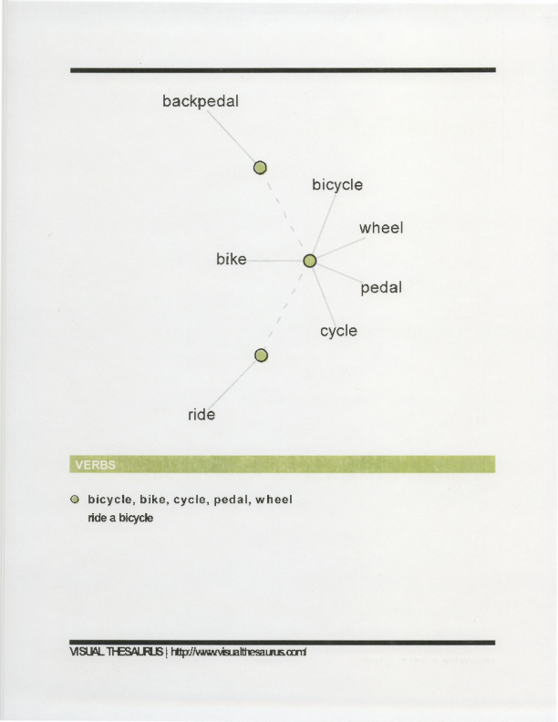

Slide 25
WordNet for Natural Language Processing
Challenge:
get a computer to “understand” language
Information retrieval
Text mining
Document sorting
Machine translation

Slide 26
Natural Language Processing
Stemming, parsing currently at >90% accuracy level
Word sense discrimination (lexical disambiguation) still a major hurdle for successful NLP
Which sense is intended by the writer (relative to a dictionary)?
Best systems: ~60% precision, ~60% recall (but human inter-annotator agreement isn’t perfect, either!)‏

Slide 27
Knowledge in text
Human language users routinely derive knowledge from text that is NOT expressed on the surface
Perhaps more knowledge is unexpressed than overtly expressed on the surface
Grasser (1981) estimates
explicit:implicit info = 1:8

Slide 28
Similarity Measurement
WordNet::Similarity is a software package that can
make it possible to measure the semantic similarity
and relatedness between a pair of concepts.

Slide 29
Measures of Similarity
Is-a hierarchy
Similarity
Limitation

Slide 30
Is-a hierarchy
Measures of similarity use information found in an
Is-a hierarchy of concepts. And nouns and verbs
are organized into hierarchies of Is-a relations.

Slide 31
Similarity
We can use measures of similarity to quantify how
much concept A is like concept B.

Slide 32
Limitation
Is-a relations in WordNet do not cross part of speech
boundaries, so similarity measures are limited to
making judgments between noun pairs (e.g. cat and
dog) and verb pairs ( e.g. run and walk).
While WordNet also includes adjectives and adverbs,
that are not organized into Is-a hierarchies, so
similarity measures can not be applied.

Slide 33
Resources:
https://wordnet.princeton.edu/
http://wordnetweb.princeton.edu/perl/webwn?s=DEMO
http://ws4jdemo.appspot.com/

Slide 34
NLTK Corpora

Slide 35
Corpora
A text corpus is a large, structured collection of texts.
NLTK comes with many corpora
The Open Language Archives Community (OLAC) provides an infrastructure for documenting and discovering language resource
OLAC is an international partnership of institutions and individuals who are creating a worldwide virtual library of language resources by:
(i) developing consensus on best current practice for the digital archiving of language resources, and
(ii) developing a network of interoperating repositories and services for housing and accessing such resources.
http://www.language-archives.org/

Slide 36
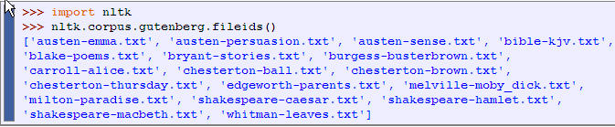
NLTK Corpora
Gutenberg Corpus
NLTK includes a small selection of texts from the Project Gutenberg electronic text archive (http://www.gutenberg.org), which contains some 25,000 free electronic books, and represents established literature
NLTK: we load the NLTK package, then ask to see the file identifiers in this corpus

Slide 37
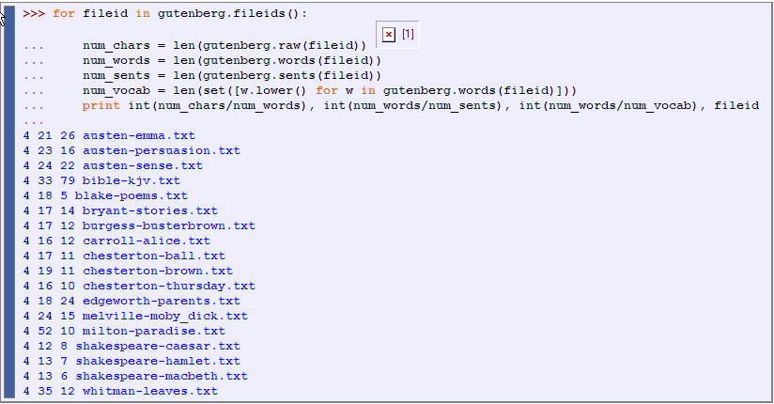
NLTK Corpora
Analyze the corpus!
Example: words(), raw(), and sents()
But also Conditional Frequency Distributions, Plotting and Tabulating Distributions

Slide 38
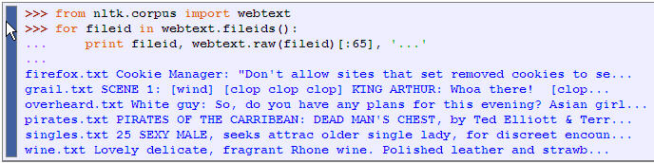
Web and Chat Text
NLTK contains less formal language as well; it’s small collection of web text includes content from a Firefox discussion forum, conversations overheard in New York, the movie script of Pirates of the Carribean, personal advertisements, and wine reviews:
There is also a corpus of instant messaging chat sessions with over 10,000 posts

Slide 39
Annotated Text Corpora
Many text corpora contain linguistic annotations, representing genres, POS tags, named entities, syntactic structures, semantic roles, and so forth.
Not part of the text in the file; it explains something of the structure and/or semantics of text
NLTK provides convenient ways to access several of these corpora
http://www.nltk.org/data
http://nltk.googlecode.com/svn/trunk/nltk_data/index.xml
Have a look!

Slide 40
Annotated Text Corpora
Grammar annotation
Semantic annotation
See Table 2 NLTK book for more examples and pointers)
Lower level annotation
Word tokenization
Sentence Segmentation
Some corpora use explicit annotations to mark sentence segmentation.
Paragraph Segmentation:
Paragraphs and other structural elements (headings, chapters, etc.) may be explicitly annotated.

Slide 41
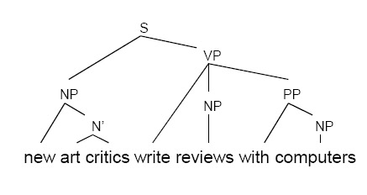
Annotated Text Corpora
Grammar annotation
Part-of-speech tags (POS): cat:NN, go: VB, and: DT etc.
Next class
CoNLL 2000 Chunking Data, Brown Corpus etc.
Parses
Dependency Treebanks, CoNLL 2007, CESS Treebanks, Penn Treebank
Chunks: Text chunking consists of dividing a text in syntactically correlated parts of words. Text chunking is an intermediate step towards full parsing.
For example : [NP new art critics] [VP write] [NP reviews] [PP with computers]
CoNLL 2000 Chunking Data

Slide 42
Annotated Text Corpora
Semantic annotation
Genres
Brown
Topics
Reuters Corpus
Named Entities
CoNLL 2002 Named Entity
Example: [PER Wol] , currently a journalist in [LOC Argentina] , played with [PER Del Bosque] in the nal years of the seventies in [ORG Real Madrid]
Sentiment polarity
Movie Reviews
Author
Language
Word senses
SEMCOR, Senseval 2 Corpus
Verb frames (eg. VerbNet)
Frames (eg. FrameNet)
Coreference annotations
Dialogue and Discourse: dialogue act tags, rhetorical structure

Slide 43
Brown Corpus
The Brown Corpus was the first million-word electronic corpus of English, created in 1961 at Brown University. This corpus contains text from 500 sources, and the sources have been categorized by genre, such as news, editorial, and so on.

Slide 44
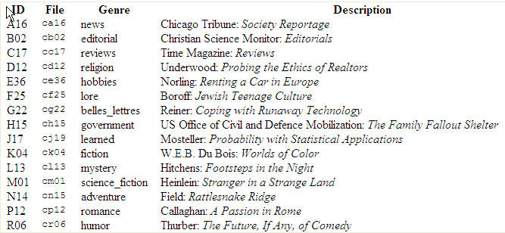
Brown Corpus
An example of each genre for the Brown Corpus
(for a complete list, see http://icame.uib.no/brown/bcm-los.html)

Slide 45
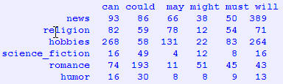
Brown Corpus
The Brown Corpus is a convenient resource for studying systematic differences between genres, a kind of linguistic inquiry known as stylistics.
For example, we can compare genres in their usage of modal verbs:
conditional frequency distributions of modal verbs conditioned on genre

Slide 46
Reuters Corpus
The Reuters Corpus contains 10,788 news documents totaling 1.3 million words.
The documents have been classified into 90 topics, and grouped into two sets, called "training" and "test“
This split is for training and testing algorithms that automatically detect the topic of a document
Unlike the Brown Corpus, categories in the Reuters corpus overlap with each other, simply because a news story often covers multiple topics.

Slide 47
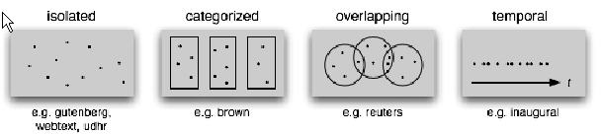
Text Corpus Structure
The simplest kind lacks any structure (i.e annotation): it is just a collection of texts (Gutenberg, web text)
Often, texts are grouped into categories that might correspond to genre, source, author, language, etc. (Brown)
Sometimes these categories overlap, notably in the case of topical categories as a text can be relevant to more than one topic. (Reuters)
Occasionally, text collections have temporal structure (news collections, Inaugural Address Corpus)

Slide 48

Lexical Resources in NLTK
NLTK includes some corpora that are nothing more than wordlists (eg the Words Corpus)
What can they be useful for?
There is also a corpus of stopwords, that is, high-frequency words like the, to and also that we sometimes want to filter out of a document before further processing.
Stopwords usually have little lexical content, and their presence in a text fails to distinguish it from other texts.

Slide 49
WordNet in NLTK
WorldNet is a semantically-oriented dictionary of English, similar to a traditional thesaurus but with a richer structure.
WordNet® is a large lexical database of English. Nouns, verbs, adjectives and adverbs are grouped into sets of cognitive synonyms (synsets), each expressing a distinct concept*.
Synsets are interlinked by means of conceptual-semantic and lexical relations. The resulting network of meaningfully related words and concepts can be navigated with the browser.
WordNet is also freely and publicly available for download.
WordNet's structure makes it a useful tool for computational linguistics and natural language processing.
NLTK includes the English WordNet, with 155,287 words and 117,659 synonym sets.
Senses and Synonyms
Consider the 2 sentences:
Benz is credited with the invention of the motorcar
Benz is credited with the invention of the automobile.
motorcar and automobile have the same meaning, i.e. they are synonyms.
* Adapted from WorldNet Website

Slide 50



WordNet
We can explore these words with the help of WordNet:
Thus, motorcar has just one possible meaning and it is identified as car.n.01, the first noun sense of car.
The entity car.n.01 is called a synset, or "synonym set", a collection of synonymous words (or "lemmas"):
Synsets also come with a prose definition and some example sentences:

Slide 51
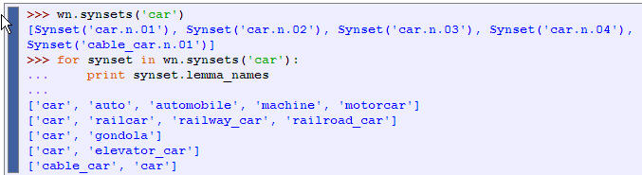
WordNet
Unlike the words automobile and motorcar, which are unambiguous and have one synset, the word car is ambiguous, having five synsets:

Slide 52
The WordNet Hierarchy
WordNet synsets correspond to abstract concepts, and they don't always have corresponding words in English.
These concepts are linked together in a hierarchy. Some concepts are very general, such as Entity, State, Event — these are called unique beginners or root synsets.
Others, such as gas guzzler and hatchback, are much more specific. A small portion of a concept hierarchy is illustrated in Figure 2.11.

Slide 53
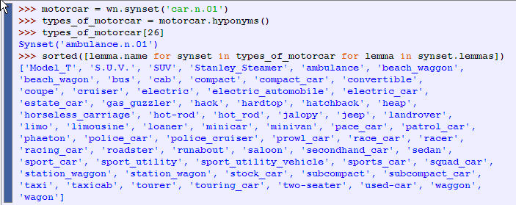
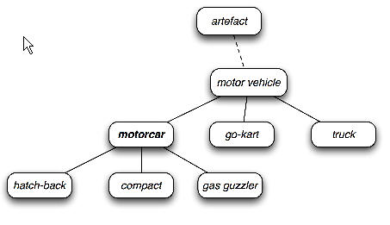
The WordNet Hierarchy
It’s very easy to navigate between concepts. For example, given a concept like motorcar, we can look at the concepts that are more specific; the (immediate) hyponyms.

Slide 54
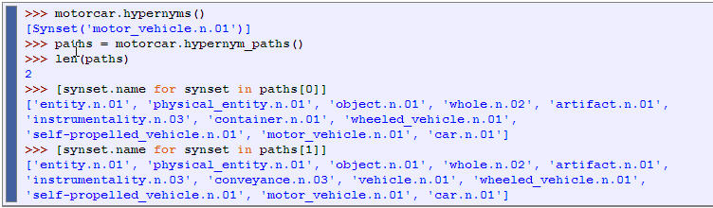
The WordNet Hierarchy
We can also navigate up the hierarchy by visiting hypernyms. Some words have multiple paths, because they can be classified in more than one way. There are two paths between car.n.01 and entity.n.01 because wheeled_vehicle.n.01 can be classified as both a vehicle and a container.
Hypernyms and hyponyms are called lexical relations because they relate one synset to another. These two relations navigate up and down the "is-a" hierarchy.

Slide 55
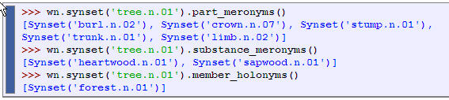
WordNet: More Lexical Relations
Another important way to navigate the WordNet network is from items to their components (meronyms) or to the things they are contained in (holonyms).
For example, the parts of a tree are its trunk, crown, and so on; the part_meronyms()
The substance a tree is made of includes heartwood and sapwood; the substance_meronyms()
A collection of trees forms a forest; the member_holonyms()

Slide 56
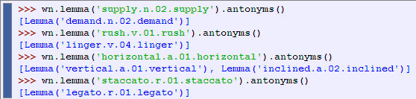
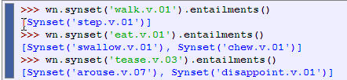
WordNet: More Lexical Relations
Some lexical relationships hold between lemmas, e.g., antonymy:
There are also relationships between verbs. For example, the act of walking involves the act of stepping, so walking entails stepping. Some verbs have multiple entailments:

Slide 57
WordNet: Semantic Similarity
Knowing which words are semantically related is useful for indexing a collection of texts, so that a search for a general term like vehicle will match documents containing specific terms like limousine.
Two synsets linked to the same root may have several hypernyms in common. If two synsets share a very specific hypernym — one that is low down in the hypernym hierarchy — they must be closely related.

Slide 58
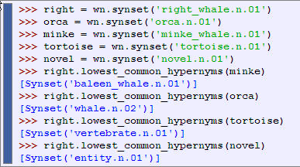
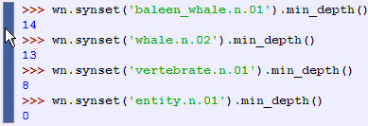
WordNet: Semantic Similarity
Of course we know that whale is very specific (and baleen whale even more so), while vertebrate is more general and entity is completely general. We can quantify this concept of generality by looking up the depth of each synset:

Slide 59
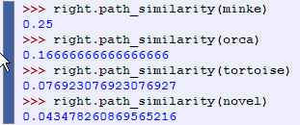
WordNet: Semantic Similarity
Similarity measures have been defined over the collection of WordNet synsets which incorporate the above insight. For example, path_similarity assigns a score in the range 0–1 based on the shortest path that connects the concepts in the hypernym hierarchy
The numbers don’t mean much, but they decrease as we move away from the semantic space of sea creatures to inanimate objects.

Slide 60
VerbNet: A Verb Lexicon
VerbNet, a hierarhical verb lexicon linked to WordNet. It can be accessed with nltk.corpus.verbnet.
*VerbNet is the largest on-line verb lexicon currently available for English.
It is a hierarchical domain-independent, broad-coverage verb lexicon with mappings to other lexical resources such as WordNet and FrameNet.
* Adapted from VerbNet website

Slide 61
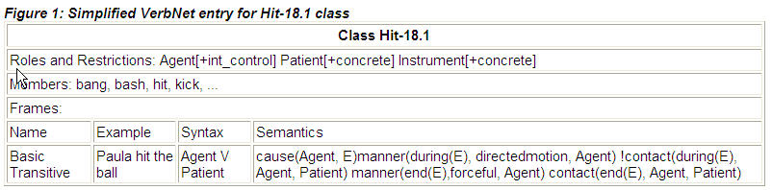
VerbNet: A Verb Lexicon
Each VerbNet class contains a set of syntactic descriptions, depicting the possible surface realizations of the argument structure for constructions such as transitive, intransitive, prepositional phrases, etc.
Semantic restrictions (such as animate, human, organization) are used to constrain the types of thematic roles allowed by the arguments
Syntactic frames may also be constrained in terms of which prepositions are allowed.
Each frame is associated with explicit semantic information
A complete entry for a frame in VerbNet class Hit-18.1
* Adapted from VerbNet website

Slide 62
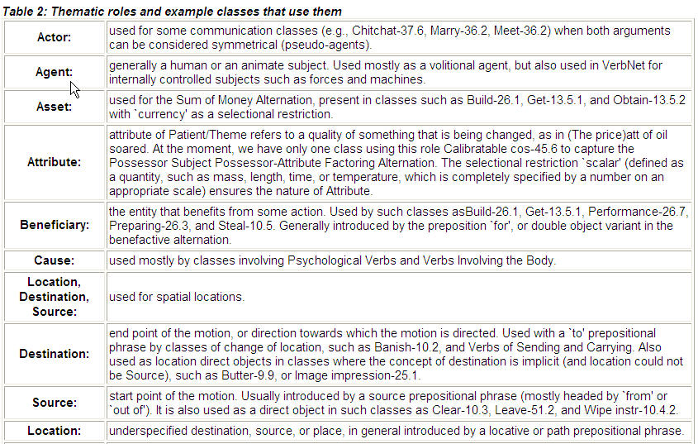
VerbNet: A Verb Lexicon
Each verb argument is assigned one (usually unique) thematic role within the class.

Slide 63
Frame Semantics & FrameNet
Frame semantics is a theory that relates linguistic semantics to encyclopaedic knowledge developed by Charles J. Fillmore
The basic idea is that one cannot understand the meaning of a single word without access to all the essential knowledge that relates to that word.
For example, one would not be able to understand the word "sell" without knowing anything about the situation of commercial transfer, which also involves, among other things, a seller, a buyer, goods, money, the relation between the money and the goods, the relations between the seller and the goods and the money, and so on.
Thus, a word activates, or evokes, a frame of semantic knowledge relating to the specific concept it refers to
A semantic frame is defined as a coherent structure of related concepts that are related such that without knowledge of all of them, one does not have complete knowledge of one of the either.
Words not only highlight individual concepts, but also specify a certain perspective in which the frame is viewed. For example "sell" views the situation from the perspective of the seller and "buy" from the perspective of the buyer.

Slide 64
FrameNet
Project housed at the International Computer Science Institute (ICSI) in Berkeley, California which produces an electronic resource based on semantic frames. http://framenet.icsi.berkeley.edu/
11,600 lexical units, in more than 960 semantic frames, exemplified in more than 150,000 annotated sentences. s

Slide 65
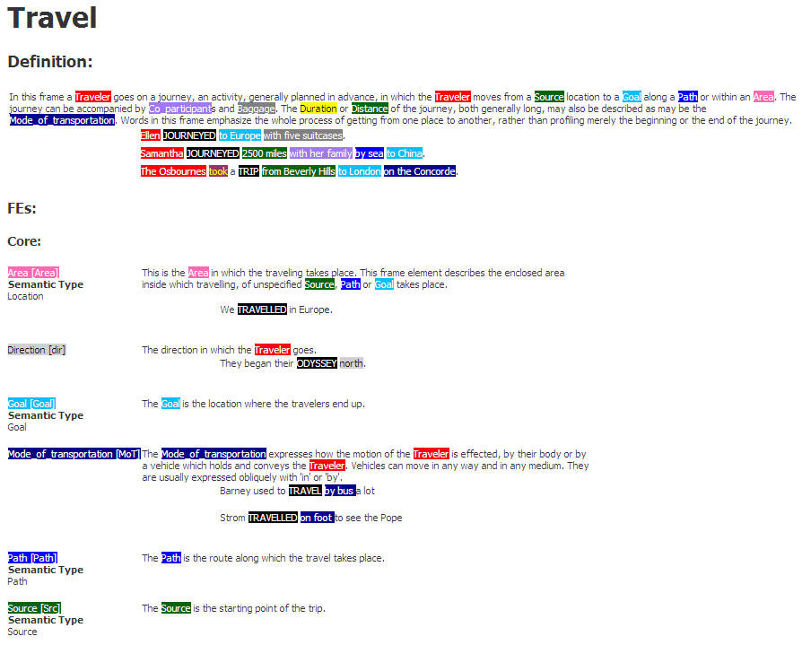
FrameNet

Slide 66
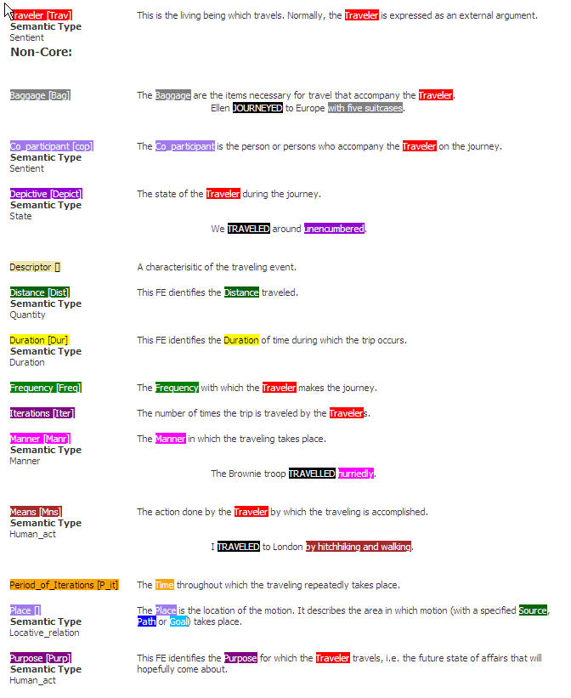

Slide 67
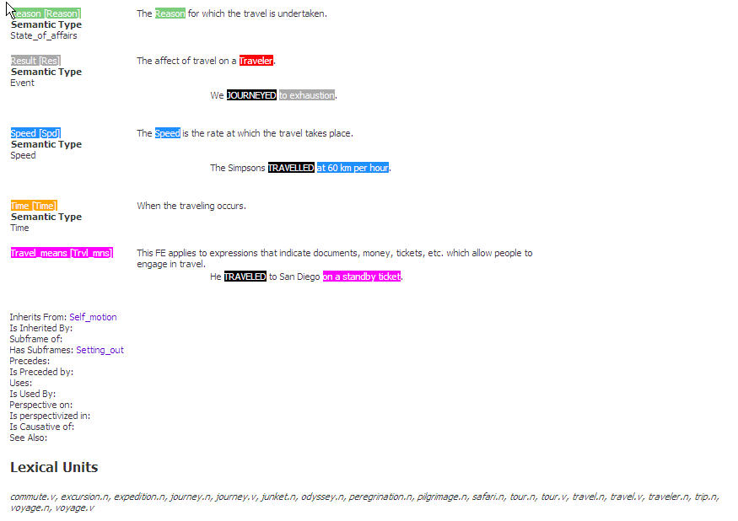

Slide 68
Domain specific: MeSH
MeSH (Medical Subject Headings)12 is the National Library of Medicine’s controlled vocabulary thesaurus; it consists of set of main terms arranged in a hierarchical structure.
There are 15 main sub-hierarchies (trees), each corresponding to a major branch of medical terminology.
For example, tree A corresponds to Anatomy, tree B to Organisms, tree C to Diseases and so on.
Every branch has several sub-branches; Anatomy, for example, consists of Body Regions (A01), Musculoskeletal System (A02), Digestive System (A03) etc.
MeSH Applications
MeSH is used for indexing articles from biomedical journals. It is also used for databases that includes cataloging of books, documents, and audiovisuals. Each bibliographic reference is associated with a set of MeSH terms that describe the content of the item.
Mainly done by hand
Search queries use MeSH vocabulary to find items on a desired topic.
(See also Medical WordNet)

Slide 69
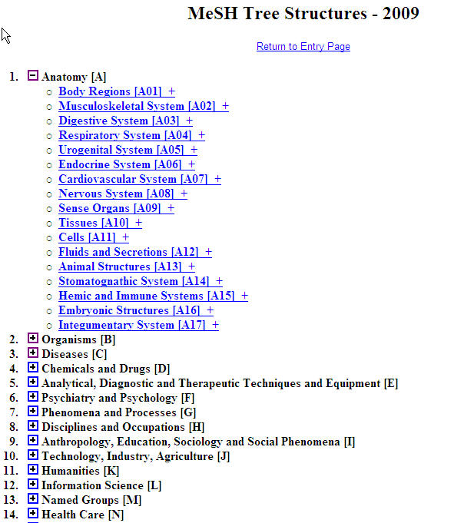

Slide 70
Corpus creation
How do we design a new language resource and ensure that its coverage, balance, and documentation support a wide range of uses?
What is a good way to document the existence of a resource we have created so that others can easily find it?
Issues on annotations

Slide 71
Notable Design Features
Balance across multiple dimensions of variation, for coverage
Corpus development involves a balance between capturing a representative sample of language usage across multiple dimensions, and capturing enough material from any one source or genre to be useful
A corpus may be annotated at many different linguistic levels, including morphological, syntactic, and discourse levels.
Even at a given level there may be different labeling schemes or even disagreement amongst annotators, such that we want to represent multiple versions.
Sharp division between the original linguistic event, and the annotations of that event.
The original text usually has an external source, and is considered to be an immutable artifact. Any transformations of that artifact which involve human judgment — even something as simple as tokenization — are subject to later revision, thus it is important to retain the source material in a form that is as close to the original as possible.

Slide 72
The Life-Cycle of a Corpus
Corpora are not born fully-formed, but involve careful preparation and input from many people over an extended period.
The lifecycle of a corpus includes data collection, annotation, quality control, and publication.
Because of the scale and complexity of the task, large corpora may take years to prepare, and involve tens or hundreds of person-years of effort.
Data collection: raw data needs to be collected, cleaned up, documented, and stored in a systematic structure.
Annotation : Various layers of annotation might be applied, some requiring specialized knowledge of the morphology or syntax of the language.
Quality control procedures can be put in place to find inconsistencies in the annotations, and to ensure the highest possible level of inter-annotator agreement.
How consistently can a group of annotators perform? We can easily measure consistency by having a portion of the source material independently annotated by two people. This may reveal shortcomings in the guidelines or differing abilities with the annotation task. In cases where quality is paramount, the entire corpus can be annotated twice, and any inconsistencies adjudicated by an expert.
It is considered best practice to report the inter-annotator agreement that was achieved for a corpus (e.g. by double-annotating 10% of the corpus). This score serves as a helpful upper bound on the expected performance of any automatic system that is trained on this corpus.
The Kappa coefficient K measures agreement between two people making category judgments
Publication. The lifecycle continues after publication as the corpus is modified and enriched during the course of research.

